Slide 1


Nano-Optic Broadband Power Splitter Design via Cycle-Consistent Adversarial Deep Learning
^{1), 2)} Yingheng Tang, ¹⁾Keisuke Kojima, ¹⁾ Toshiaki Koike-Akino, ¹⁾ Ye Wang, ¹⁾ Devesh Jha, ¹⁾ Kieran Parsons, and ²⁾ Minghao Qi
  Mitsubishi Electric Research Laboratories, Cambridge, MA
  Purdue University, West Lafeyette, IN
1

Slide 2
Outline
Introduction
ACVAE model (previous work)
ACVAE model with cycle-consistency
Result
Summary
2

Slide 3
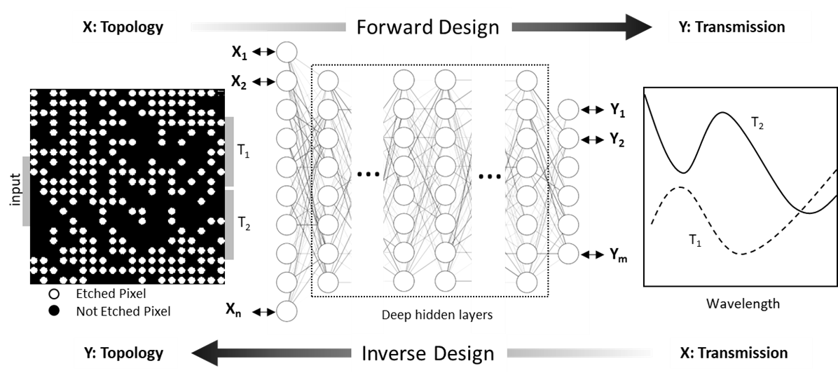
Introduction
Mean
Variance
We want to use the neural network to accelerate the design process for the photonic devices.
Previously we have created the forward and inverse network.
The inverse network still has room for further improvement.
Alternatively, generative modeling, such as conditional variational autoencoders (CVAE) or a generative adversarial network (GAN) can generate improved designs.
Tahersima, M.H., Kojima, K., Koike-Akino, T., Jha, D., Wang, B., Lin, C. and Parsons, K., Scientific Reports (Nature), 2019.
Tahersima, M.H., Kojima, K., Koike-Akino, T., Jha, D., Wang, B., Lin, C. and Parsons, K., OFC, 2019.
3

Slide 4
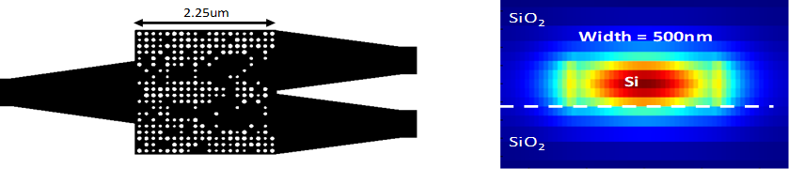
Target Devices: Power splitters
Arbitrary splitting ratio
Low Excess loss and low reflection
Very compact device footprint
220 nm-thick SOI with SiO2 cladding
40-72 nm-diameter holes etched into Si and filled with SiO₂
113 nm pitch: subwavelength region
Lumerical FDTD: 3D FDTD simulations
4

Slide 5
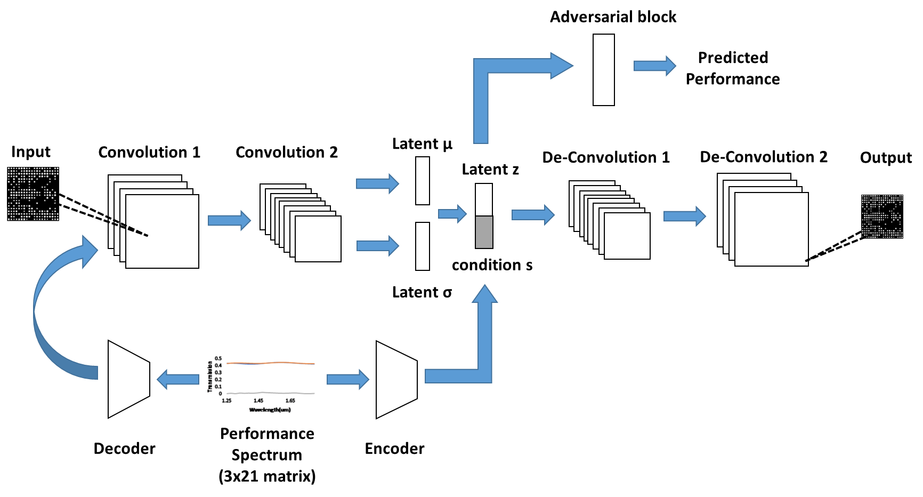
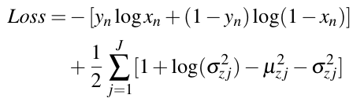
The ACVAE model (previous work)
Adversarial censoring
Encoder
Decoder
Cross Entropy Loss
KL Divergence
Previously , we used the Adversarial Conditional Variational Autoencoder (A-CVAE) structure to create a generative network for the power splitters with different splitting ratio.
The adversarial block reduces the leakage of condition information to the latent variables.
The model can be used to generate the splitters with arbitrary splitting ratio without further optimization process
We want to further improve the generated device performance (total transmission and splitting ratio) with limited data(especially for the 8:2 device).
Tang, Y., Kojima, K., Koike-Akino, Wang, Y., Wu, P., Xie, Y., Tahersima, M.H., T., Jha, D., Parsons, K., Qi, M., Laser & Photonics Reviews, 2020.
Tang, Y., Kojima, K., Koike-Akino, Wang, Y., Wu, P., Tahersima, M.H., T., Jha, D., Parsons, K., Qi, M., OFC, 2020.
5

Slide 6
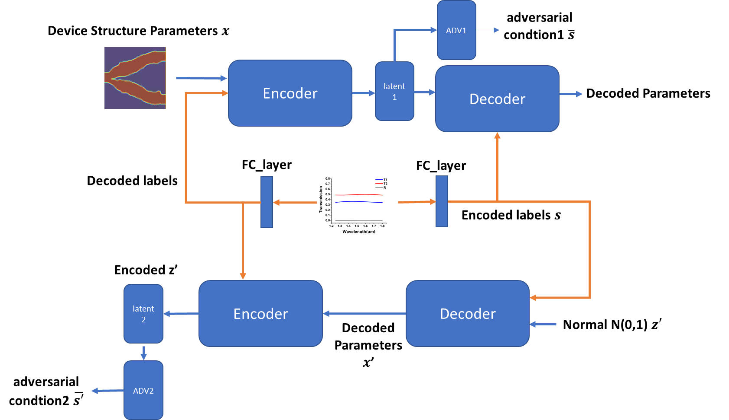

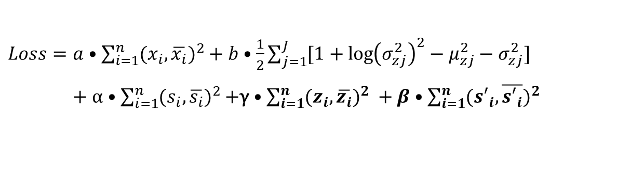
The ACVAE model with cycle consistency
In addition to the encoder-decoder structure for forward construction, the reversed-order decoder-encoder pipeline is also trained for latent space consistency.
We hope to apply the cycle-consistency idea to further reduce leakage of information associated with specified factors of latent variation.
~16000 training data (including both binary(~15000) and variable hole size (~1000) HV
Update frequency between CAVE blocks and adversarial blocks is (3:1)
Mean
Variance
$Loss=a•\sum_{i=1}^{n}{{(x_{i},\overline{x_{i}})}^{2}}+b•\frac{1}{2}\sum_{j=1}^{J}{[1+\log{{\left(σ_{zj}^{2}\right)}^{2}−μ_{zj}^{2}}−σ_{zj}^{2}}]$
$+$ $α•\sum_{i=1}^{n}{{(s_{i},\overline{s_{i}})}^{2}}$+γ $•\sum_{i=1}^{n}{{(z_{i},\overline{z_{i}})}^{2}} +β•\sum_{i=1}^{n}{{({s′}_{i},\overline{{s′}_{i}})}^{2}}$
6

Slide 7
The ACVAE model with cycle consistency
Detail network parameters for the Encoders and Decodes
Layer | Encoder | Decoder
1 | Convolution (channel= 16, kernel = 3, stride = 1, padding =1) | MLP((60 + 9) -> 800
2 | Batchnorm(16) | Convolution (channel= 32, kernel = 3, stride = 2, padding =1)
3 | Relu + Maxpooling | Batchnorm(32)
4 | Convolution (channel= 32, kernel = 3, stride = 1, padding =1) | Convolution (channel= 16, kernel = 3, stride = 2, padding =1)
5 | Batchnorm(32) | Batchnorm(16)
6 | Relu + Maxpooling | Sigmoid
7 | MLP (800 -> 60) + Relu
7

Slide 8
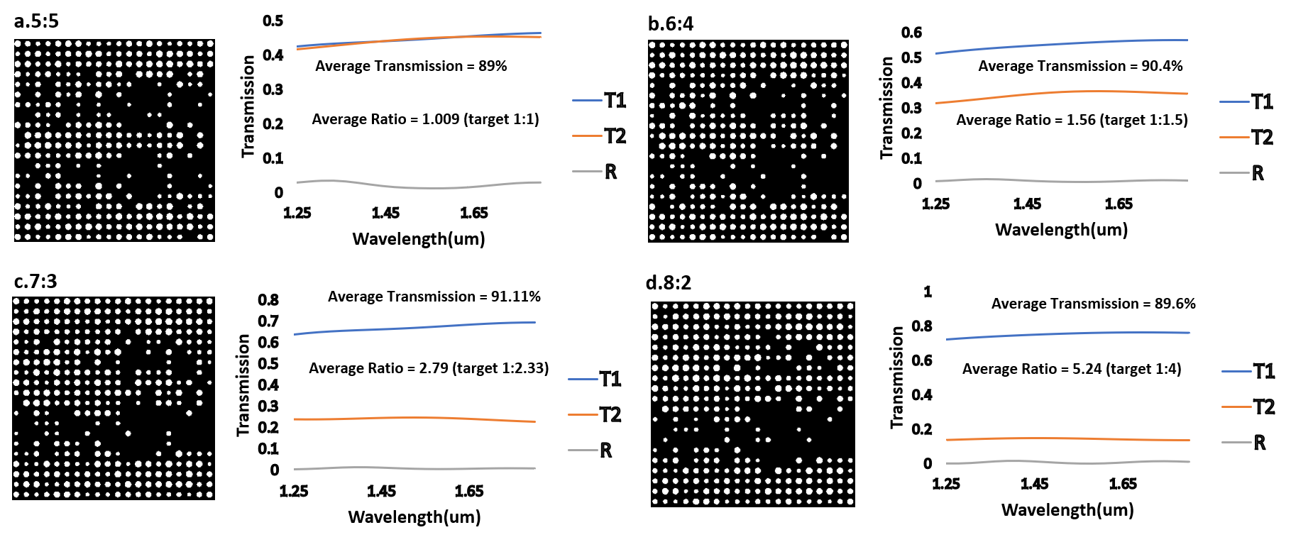
Result (power splitter)
Four different types of devices are generated with the splitting ratio of 5:5, 6:4, 7:3, 8:2
The overall total transmission is ~ 90% across the large bandwidth (550nm), the actual splitting ratio is very close to the target.
8

Slide 9
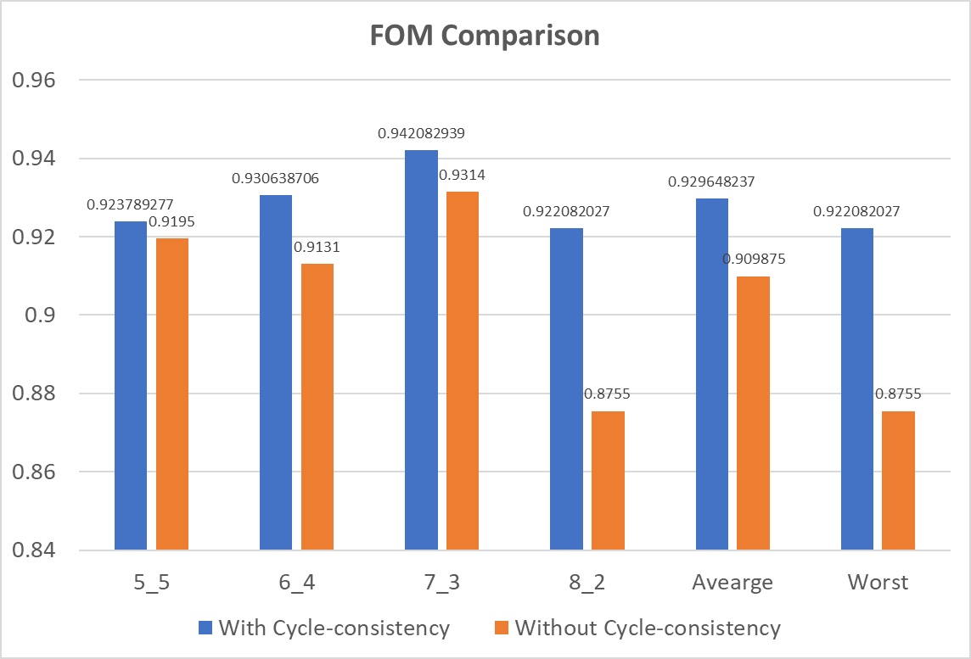
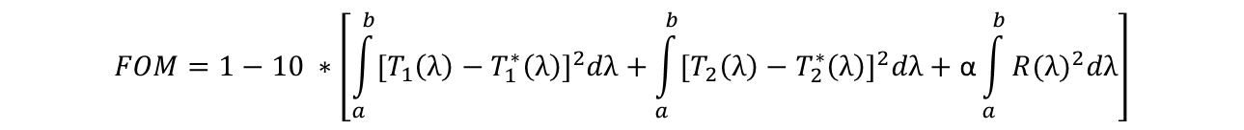
Result (power splitter)
We introduce the Figure of Merit(FOM) to better describe the device optical performance
The FOM comparison between the Adversarial CVAE with/without the cycle-consistency
Generate 50 devices for each type of splitter(5_5, 6_4, 7_3 and 8_2)
Running FDTD simulation and calculate the average FOM for each type of devices and the overall FOM
The comparison of FOM shows decent improvement using the new model (with cycle consistency)
$$FOM=1−10 ∗\left[{\int_{a}^{b}{[T_{1}\left(λ\right)−T_{1}^{∗}\left(λ\right)}]}^{2}dλ+{\int_{a}^{b}{[T_{2}\left(λ\right)−T_{2}^{∗}\left(λ\right)}]}^{2}dλ+{\text{α}\int_{a}^{b}{R(λ})}^{2}dλ\right]$$
Transmission difference of Output Port 1
Transmission difference of Output Port 2
Reflection difference of Input Port
9

Slide 10
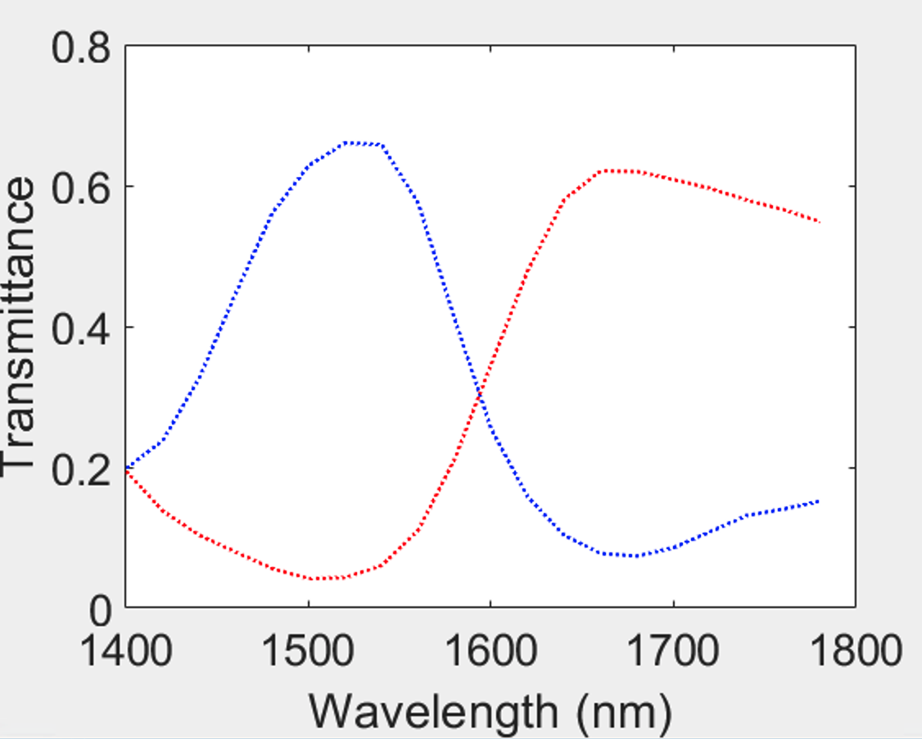
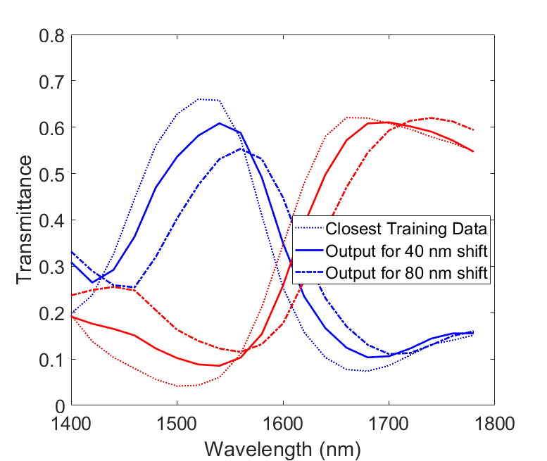
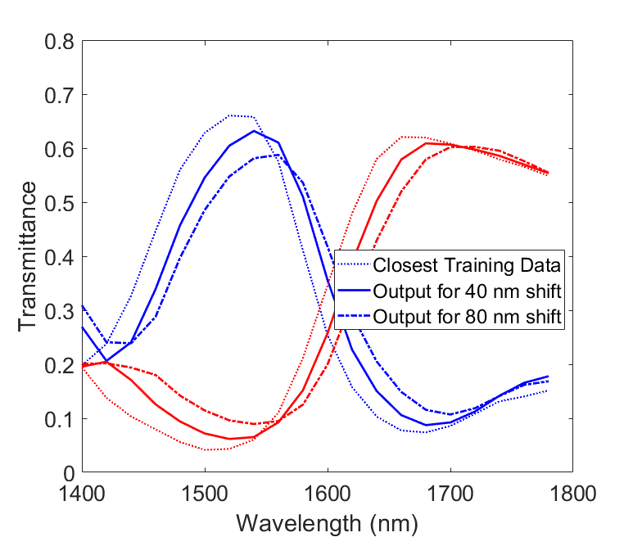
Result (WDM splitter)
Using the same platform, we generated WDM filters targeting different wavelengths.
16 optimization runs are conducted targeting different wavelengths.
Total of 21,530 the training data.
We tried ACVAE with and without cycle consistency.
We picked the WDM splitter with the longest wavelength and tried to generate new devices with +40nm and +80nm shifted targets (extrapolation).
ACVAE-CC gives better splitter performances
  Less change in the transmittance peak/bottom
Training data example
ACVAE
ACVAE-CC
10

Slide 11
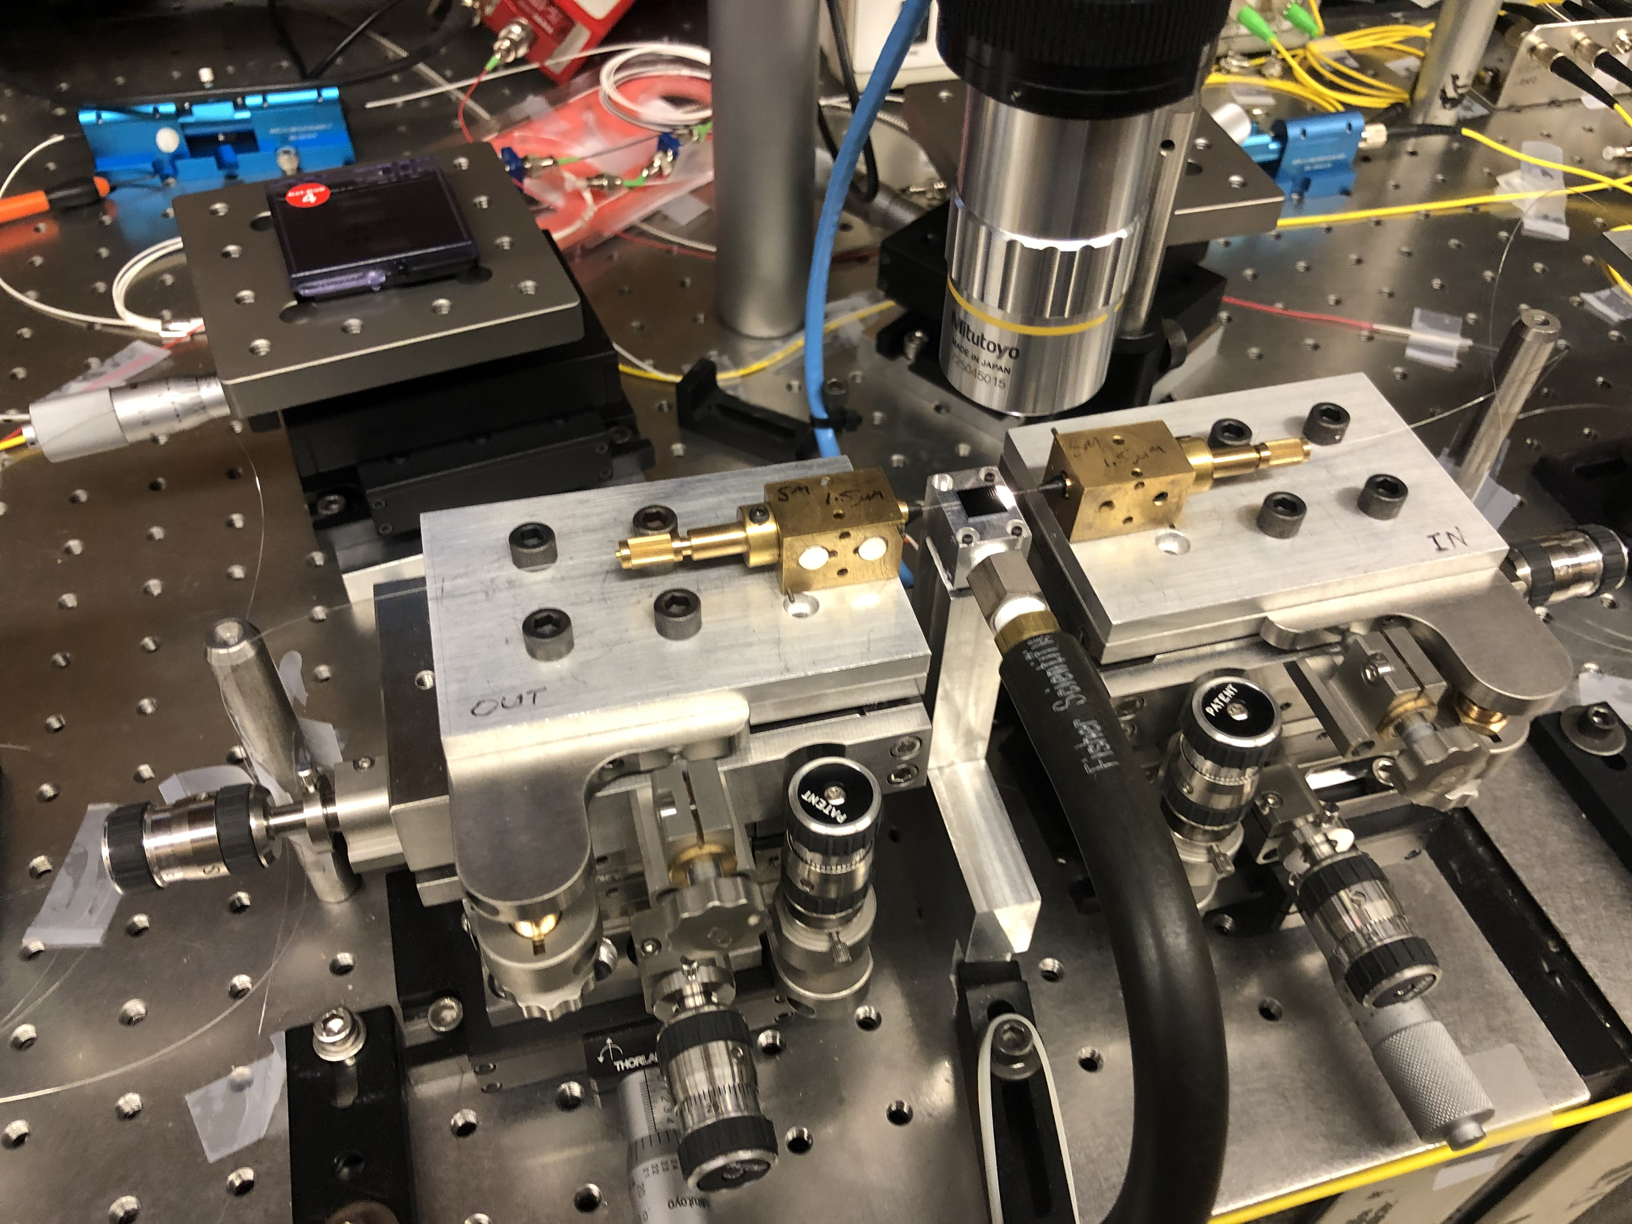
Result (beam splitter measurement result)
The chip and the mask is designed at MERL and is fabricated through external foundry(Applied Nanotools).
Edge coupling measurement of the power splitter is conducted in Purdue (total transmission and power splitting ratio).
For the first version of the devices, we put devices with constant hole size as well to increase the chance of success
Source
DUT
Power meter
Edge coupling
Edge coupling
11

Slide 12
Result (beam splitter measurement result)
Overall, 5:5 and 6:4 device have shown good performance with small loss.
For 5:5 device, the splitting ratio is close to 1 and the insertion loss is ~-0.5dB
For 6:4 device, the splitting ratio is ranging from 0.708 to 0.631 (target:0.67) and the insertion loss is ~-0.3dB
Device (5:5)
a.
b.
Device (6:4)
a.
b.
12

Slide 13
Result (beam splitter measurement result)
Device (7:3)
The insertion loss for the 7:3 and 8:2 devices are larger.
For 7:3 device, the splitting ratio is ranging from 0.51 to 0.38 (target:0.43) with insertion loss to be -2.5dB
For 8:2 device, the splitting ratio is ranging from 0.32 to 0.26 (target :0.25) with insertion loss to be -1dB
a.
b.
Device (8:2)
a.
b.
13

Slide 14
Summary
We further improved the ACVAE model by applying the cycle consistency concept to it.
The model can be used to generate the splitters with arbitrary splitting ratio without further optimization process
The final generated devices can reach over 90% transmission across a wide bandwidth (1250nm – 1800nm)
The ACVAE model with cycle consistency also shows decent improvement from our previous ACVAE model in terms of Figure of Merit (FOM).
Some measurements have been performed to experimentally prove our model-generated devices are functioning properly.
14

Slide 15
Thank you

