Slide 1
Data Privacy and Protection on Deep Leakage from Gradients by Layer-Wise Pruning
Bryan Liu
Toshiaki Koike-Akino
Ye Wang
Kyeong Jin Kim
Matthew E. Brand
Shuchin Aeron
Kieran Parsons

Slide 2
Agenda
Federated Learning
Inverting Gradients
  Objective function
  Element-wise threshold-based pruning
Proposed privacy and data protection method (local user)
  Layer-wise pruning
Proposed sequential update method (attacker)
Numerical Results
Conclusion

Slide 3



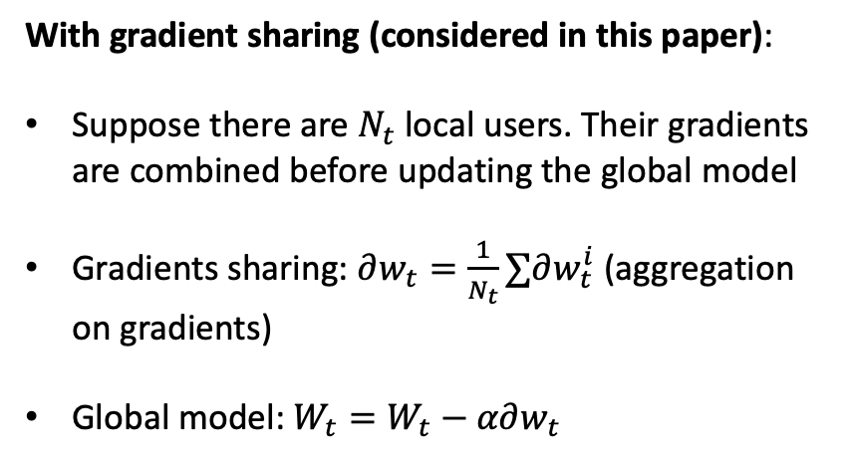
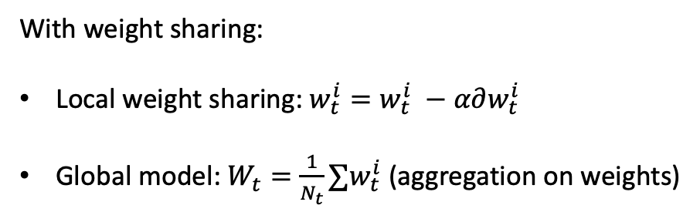
Federated Learning
Shared gradients/weights
With gradient sharing (considered in this paper):
Suppose there are $N_{t}$ local users. Their gradients are combined before updating the global model
Gradients sharing: $∂w_{t}=\frac{1}{N_{t}}∑∂w_{t}^{i}$ (aggregation on gradients)
Global model: $W_{t}=W_{t}−α∂w_{t}$
Aggregation at the central server
Local model
Local model
Global Model
With weight sharing:
Local weight sharing: $w_{t}^{i}=w_{t}^{i} −α∂w_{t}^{i}$
Global model: $W_{t}=\frac{1}{N_{t}}∑w_{t}^{i}$ (aggregation on weights)
Local model

Slide 4

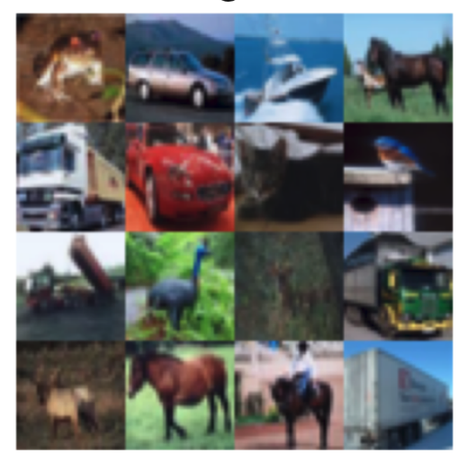
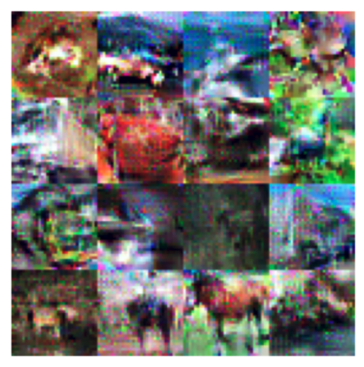

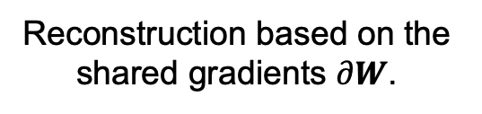
Deep Leakage from Gradients
Shared gradients: $∂W$
Local model
Global Model
Original mini-batch of
training data
Reconstruction based on the shared gradients $∂W$.
Reference:
Y. Huang, S. Gupta, Z. Song, K. Li, and S. Arora, “Evaluating gradient inversion attacks and defenses in federated learning,” arXiv: 2112.00059, 2021.

Slide 5

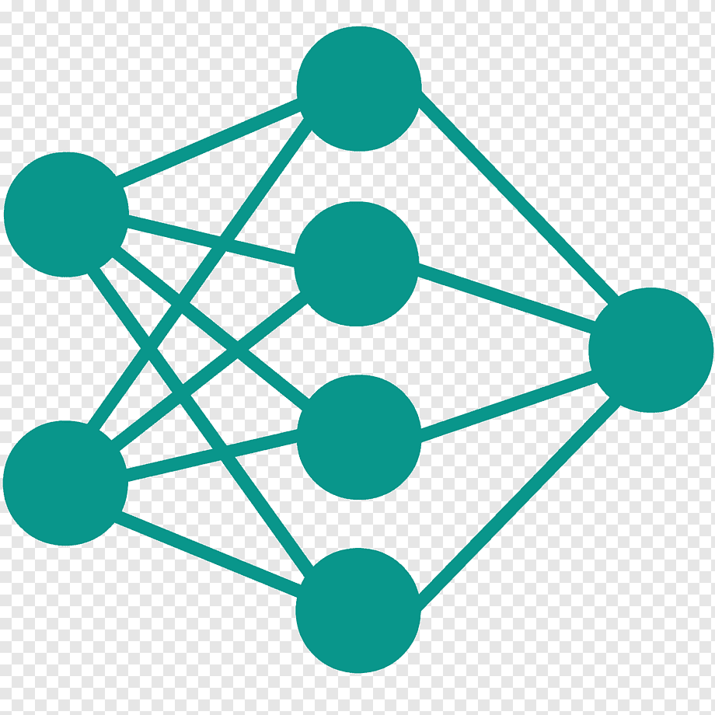



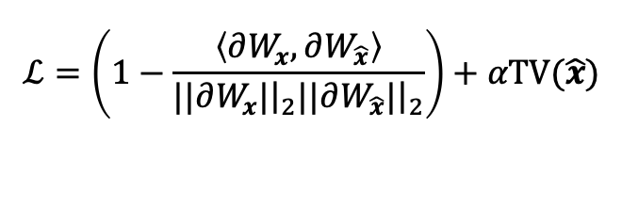



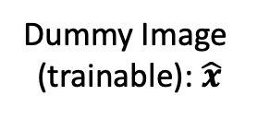






Deep Leakage from Gradients
Source Image Reconstruction from the Shared Gradients
Shared gradients: $∂W_{x}$
Gradients of dummy image: $∂W_{\hat{x}}$
$$ℒ$$
Prediction: ${\hat{y}}_{x}$
Prediction: ${\hat{y}}_{\hat{x}}$
Loss function
Loss function
Label: $y$
Label: $y$
Source data $x$
Dummy Image
(trainable): $\hat{x}$
Local User
Attacker
$$ℒ=\left(1−\frac{\left\langle ∂W_{x},∂W_{\hat{x}}\right\rangle }{|{\left.​|∂W_{x}|\right|}_{2}|{\left.​|∂W_{\hat{x}}|\right|}_{2}}\right)+αTV(\hat{x})$$
Objective function:
TV($\hat{x}$): total variation function of dummy image $\hat{x}$.
With stochastic gradient descent, trainable dummy image will be gradually reconstructed to the source data
Iteration index: 90
Iteration index: 130
Iteration index: 300
Reference:
J. Geiping, H. Bauermeister, H. Dröge, and M. Moeller, “Inverting gradients – how easy is it to break privacy in federated learning?” arXiv: 2003.14053, 2020.

Slide 6
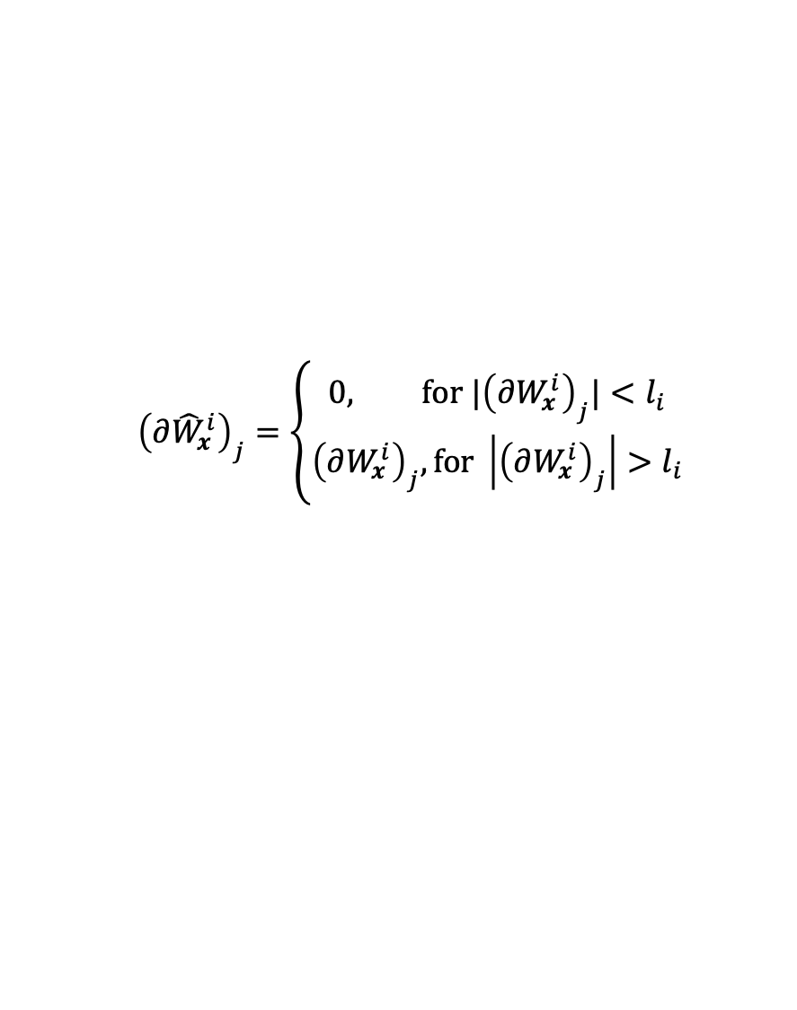
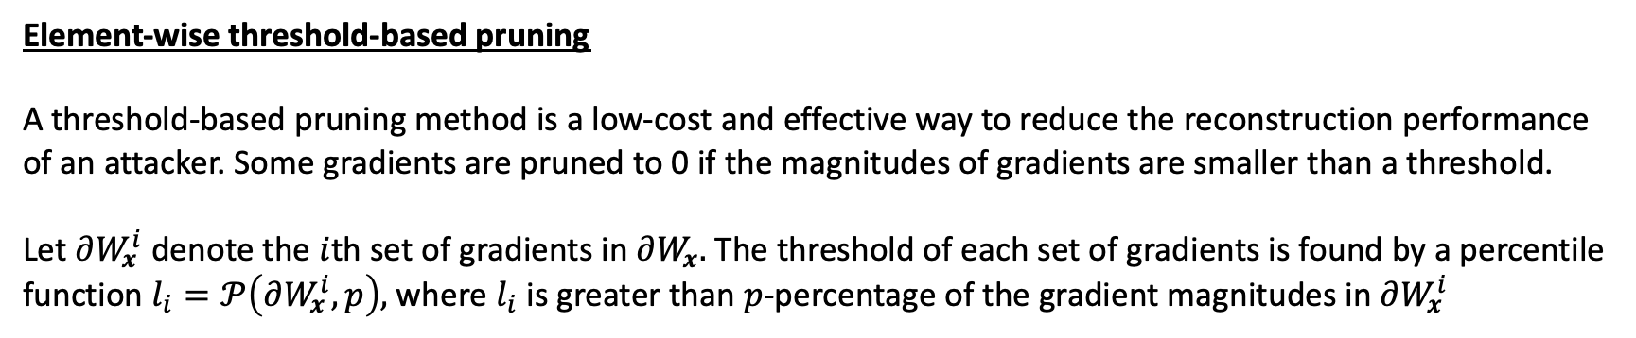
Deep Leakage from Gradients
Element-wise threshold-based pruning
A threshold-based pruning method is a low-cost and effective way to reduce the reconstruction performance of an attacker. Some gradients are pruned to 0 if the magnitudes of gradients are smaller than a threshold.
Let $∂W_{x}^{i}$ denote the $i$th set of gradients in $∂W_{x}.$ The threshold of each set of gradients is found by a percentile function $l_{i}=𝒫\left(∂W_{x}^{i}, p\right),$ where $l_{i}$ is greater than $p$-percentage of the gradient magnitudes in $∂W_{x}^{i}$
$${\left(∂{\hat{W}}_{x}^{i}\right)}_{j}=\left\{\begin{aligned}0, for |{\left(∂W_{x}^{i}\right)}_{j}|<l_{i} \\ &{\left(∂W_{x}^{i}\right)}_{j},for \left|{\left(∂W_{x}^{i}\right)}_{j}\right|>l_{i}\end{aligned}\right.$$
Pruning part of the gradients can be viewed as signals with incomplete sampling, which means the attacker can still recover the source images with a reasonable accuracy
Reference:
L. Zhu, Z. Liu, and S. Han, “Deep leakage from gradients,” Adv. Neural Inf. Process. Syst., vol. 32, 2019.

Slide 7
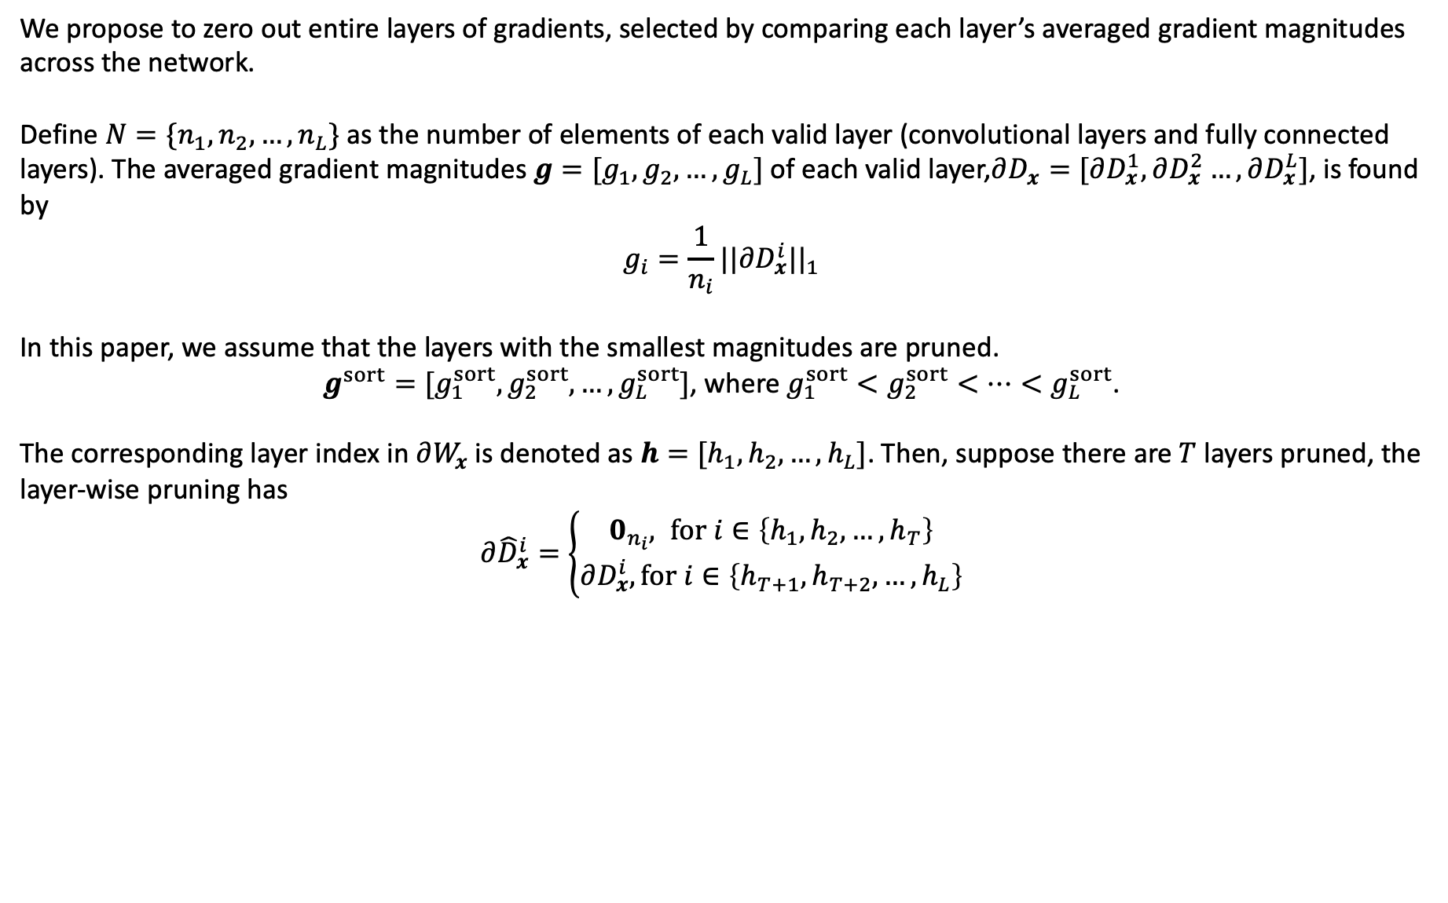
Dynamic System - Layer-wise Pruning and Sequential Update
Layer-wise Pruning (local user)
We propose to zero out entire layers of gradients, selected by comparing each layer’s averaged gradient magnitudes across the network.
Define $N=\{n_{1}, n_{2}, …, n_{L}\}$ as the number of elements of each valid layer (convolutional layers and fully connected layers). The averaged gradient magnitudes ${g=[g}_{1},g_{2},…,g_{L}]$ of each valid layer,$∂D_{x}=[∂D_{x}^{1},∂D_{x}^{2}…,∂D_{x}^{L}]$, is found by
$$g_{i}=\frac{1}{n_{i}}{||∂D_{x}^{i}||}_{1}$$
In this paper, we assume that the layers with the smallest magnitudes are pruned.
${g^{sort}=[g}_{1}^{sort},g_{2}^{sort},…,g_{L}^{sort}]$, where $g_{1}^{sort}<g_{2}^{sort}<…<g_{L}^{sort}$.
The corresponding layer index in $∂W_{x}$is denoted as ${h=[h}_{1},h_{2},…,h_{L}]$. Then, suppose there are $T$ layers pruned, the layer-wise pruning has
$∂{\hat{D}}_{x}^{i}=\left\{\begin{aligned}0_{n_{i}}, for i∈\left\{h_{1}, h_{2},…,h_{T}\right\} \\ &∂D_{x}^{i},for i∈\left\{h_{T+1}, h_{T+2},…,h_{L}\right\}\end{aligned}\right.$

Slide 8
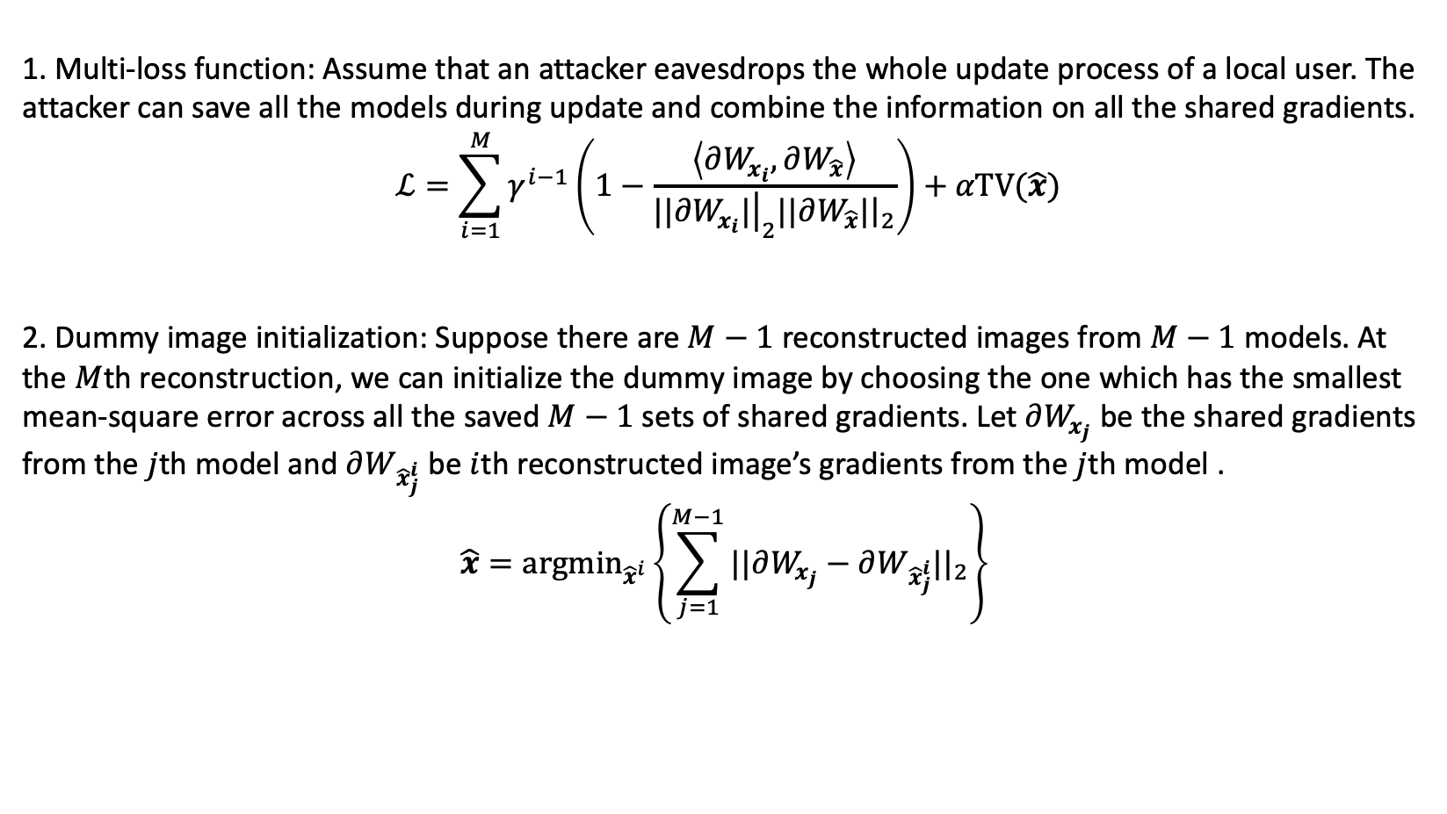
Dynamic System - Layer-wise Pruning and Sequential Update
Sequential Update (attacker)
1. Multi-loss function: Assume that an attacker eavesdrops the whole update process of a local user. The attacker can save all the models during update and combine the information on all the shared gradients.
$$ℒ=\sum_{i=1}^{M}{γ^{i−1}\left(1−\frac{\left\langle ∂W_{x_{i}},∂W_{\hat{x}}\right\rangle }{|{\left.​|∂W_{x_{i}}|\right|}_{2}|{\left.​|∂W_{\hat{x}}|\right|}_{2}}\right)}+αTV(\hat{x})$$
2. Dummy image initialization: Suppose there are $M−1$ reconstructed images from $M−1$ models. At the $M$th reconstruction, we can initialize the dummy image by choosing the one which has the smallest mean-square error across all the saved $M−1$ sets of shared gradients. Let $∂W_{x_{j}}$ be the shared gradients from the $j$th model and $∂W_{{\hat{x}}_{j}^{i}}$ be $i$th reconstructed image’s gradients from the $j$th model .
$$\hat{x}={argmin}_{{\hat{x}}^{i}}\left\{\sum_{j=1}^{M−1}{{||∂W_{x_{j}}−∂W_{{\hat{x}}_{j}^{i}}||}_{2}}\right\}$$

Slide 9
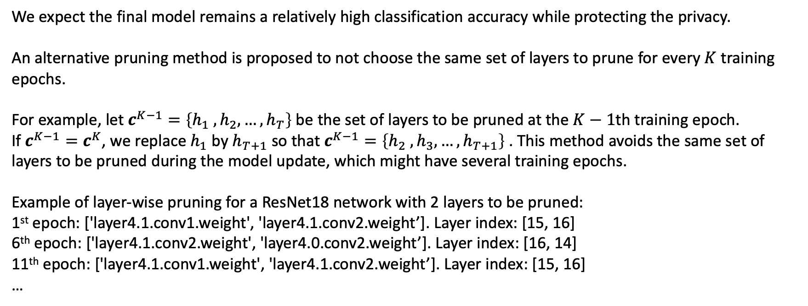
Dynamic System - Layer-wise Pruning and Sequential Update
Layer-wise Pruning (local user) – alternating update
We expect the final model remains a relatively high classification accuracy while protecting the privacy.
An alternative pruning method is proposed to not choose the same set of layers to prune for every $K$ training epochs.
For example, let $c^{K−1}=\left\{h_{1} , h_{2}, …, h_{T}\right\}$ be the set of layers to be pruned at the $K−1$th training epoch.
If $c^{K−1}=c^{K}$, we replace $h_{1}$ by $h_{T+1}$ so that $c^{K−1}=\left\{h_{2} , h_{3}, …, h_{T+1}\right\}$ . This method avoids the same set of layers to be pruned during the model update, which might have several training epochs.
Example of layer-wise pruning for a ResNet18 network with 2 layers to be pruned:
1st epoch: ['layer4.1.conv1.weight', 'layer4.1.conv2.weight’]. Layer index: [15, 16]
6th epoch: ['layer4.1.conv2.weight', 'layer4.0.conv2.weight’]. Layer index: [16, 14]
11th epoch: ['layer4.1.conv1.weight', 'layer4.1.conv2.weight’]. Layer index: [15, 16]
…

Slide 10
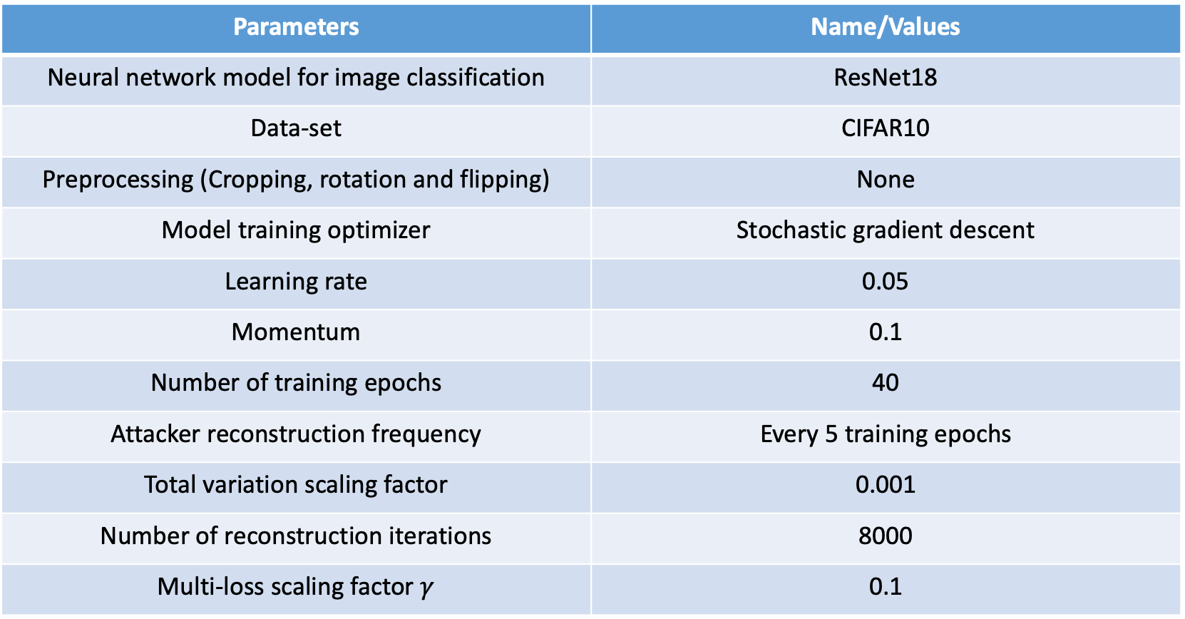
Numerical Results
System model and training hyper-parameters
Parameters | Name/Values
Neural network model for image classification | ResNet18
Data-set | CIFAR10
Preprocessing (Cropping, rotation and flipping) | None
Model training optimizer | Stochastic gradient descent
Learning rate | 0.05
Momentum | 0.1
Number of training epochs | 40
Attacker reconstruction frequency | Every 5 training epochs
Total variation scaling factor | 0.001
Number of reconstruction iterations | 8000
Multi-loss scaling factor $γ$ | 0.1

Slide 11
Numerical Results
Model classification accuracy and reconstruction performance
Classification Model Accuracy
Attacker Reconstruction

Slide 12








Numerical Results
Examples of reconstruction
Original test images
Layer-wise pruning – 2 layers
Element-wise pruning – $p = 0.43$
Training epoch index: 0. SSIM: 0.13
Training epoch index: 0. SSIM: 0.48
Training epoch index: 20. SSIM: 0.28
Training epoch index: 20. SSIM: 0.79
Training epoch index: 40. SSIM: 0.30
Training epoch index: 40. SSIM: 0.75

Slide 13
Numerical Results
Layer-wise pruning (1 layer) vs. SSIM
In this figure, we show the structural similarity performance by pruning 18 layers in the ResNet18 one-by-one.
The classification model is unchanged, but we repeat the reconstruction process by pruning each layer.
We observe that pruning the last layer, which contains the label information, has the most significant effect to the reconstruction.
Last layer

Slide 14
Conclusion
The trade-off between privacy protection and test accuracy for classifying images is demonstrated by computing the area under the curves of test accuracy and structural similarity (SSIM) between the reconstructed and source images.
We propose a magnitude-based alternating layer-wise pruning method to prevent data leakage. It is shown that the alternating optimization method does not influence the final test accuracy on classification when the number of layers to be pruned is small.
By comparing to the element-wise threshold-based pruning method, we demonstrate that the layer-wise pruning method can efficiently prevent data leakage during the model update.
A sequential reconstruction method is proposed for the attacker, which gradually improves the reconstruction performance during the model update.

